Slide 1
PREDICTION & CLASSIFICATION USING REGRESSION IN ML

Slide 2
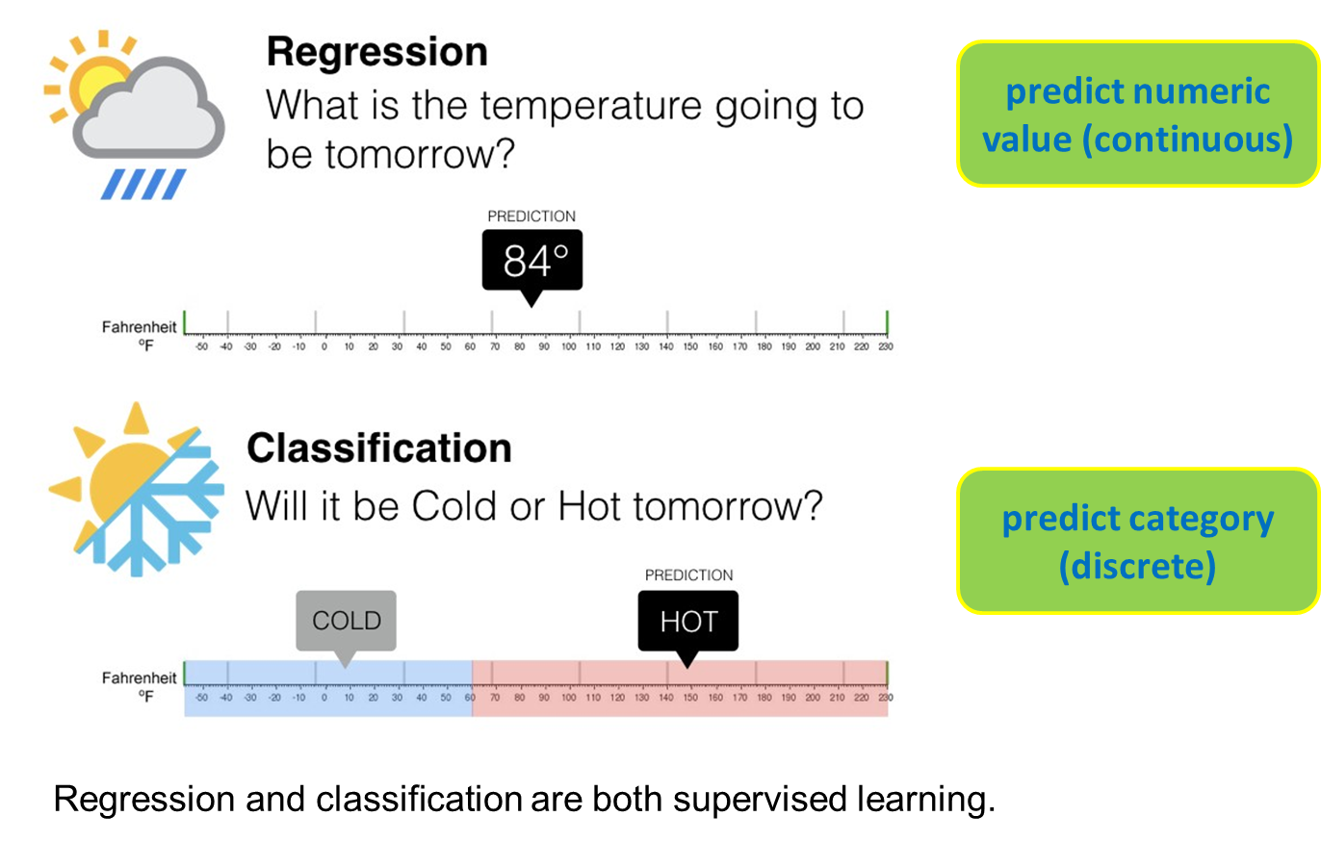
Regression vs Classification

Slide 3
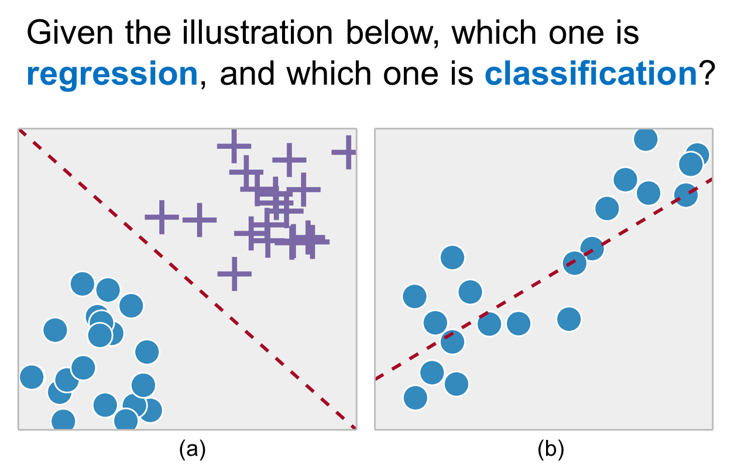
CHECK IT OUT…….?

Slide 4
What is Regression?
Regression analysis is a study that allows us to predict a continuous outcome variable/explained variable/dependent variable (y)
based on the value of one or multiple
predictor variable(s)/explanatory variable(s)/independent variable(s) (x).
If there is only one independent variable, the regression analysis is called simple regression.
simple linear regression and non-linear regression
If the number of independent variables is more than one, it is called multiple regression.
The outcome of regression analysis is an equation.
This equation is a function that receives value(s) of independent variable(s) to produce/predict a value of the dependent variable.

Slide 5
Simple Linear Regression (SLR)
x: independent variable / explanatory variable / predictor variable
y: dependent variable / explained variable / outcome variable
The result equation: linear equation

Slide 6
CASE EXAMPLES OF SLR
Relationship between the working duration of a machine with the quality of products produced by the machine.
Relationship between the number of employees with the number of items being produced.
Relationship between room temperature in a factory with damaged items being produced.

Slide 7
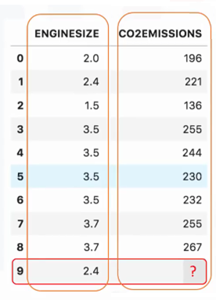
CASE EXAMPLES OF SLR
x: independent variable
y: dependent variable
Task: predicting CO2 emissions based on the engine size of a car.
x: engine size
y: CO2 emissions
new data sample

Slide 8
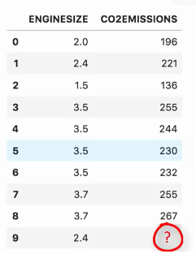
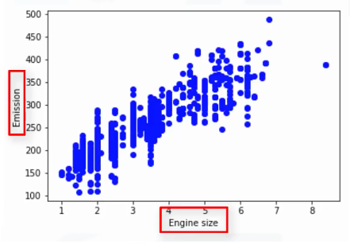
HOW DOES THE SLR WORK
214
2.4
x = 2.4
y = 214
How to find this line?

Slide 9



SLR REPRESENTATION
: predicted emission
: engine size
: parameters
How to find the values for the two parameters ( )?

Slide 10
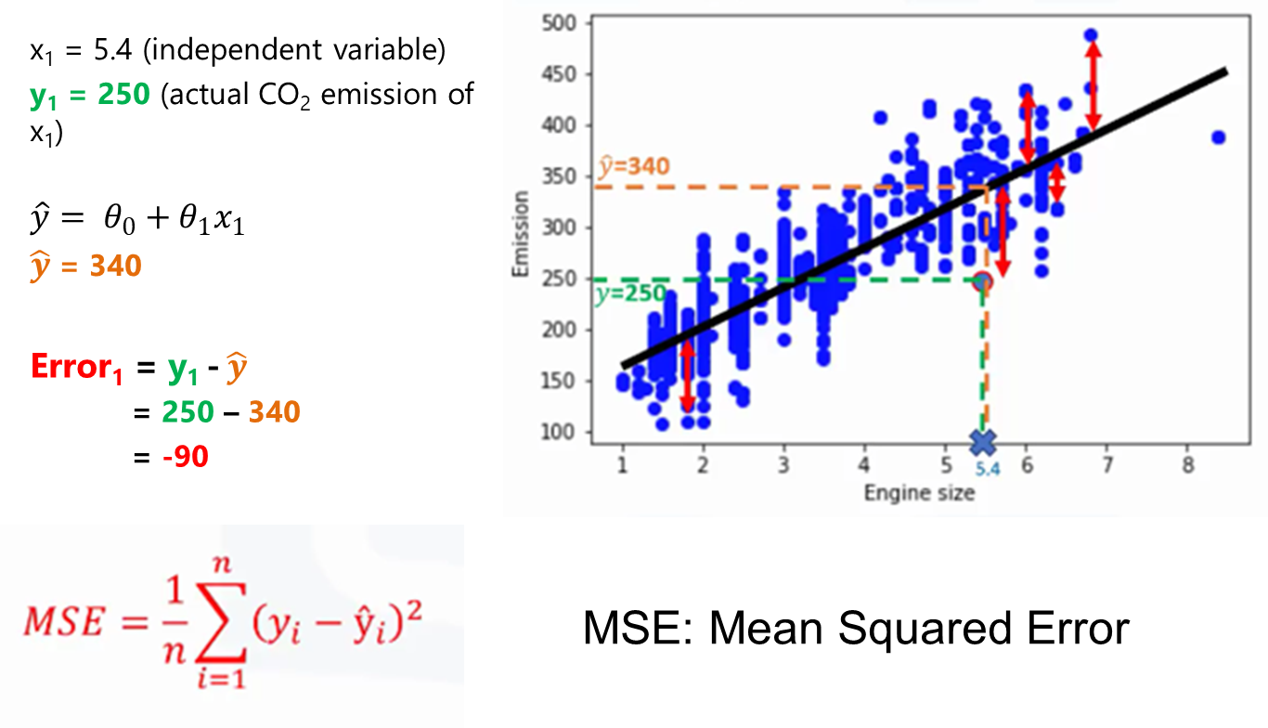
How to Find Fitted Line?

Slide 11
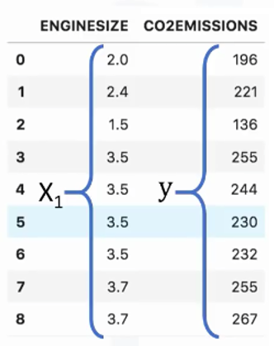



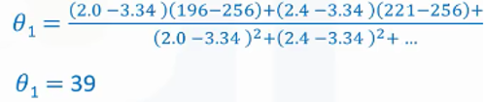
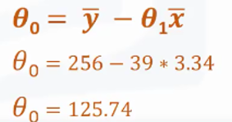

Parameters Estimation

Slide 12
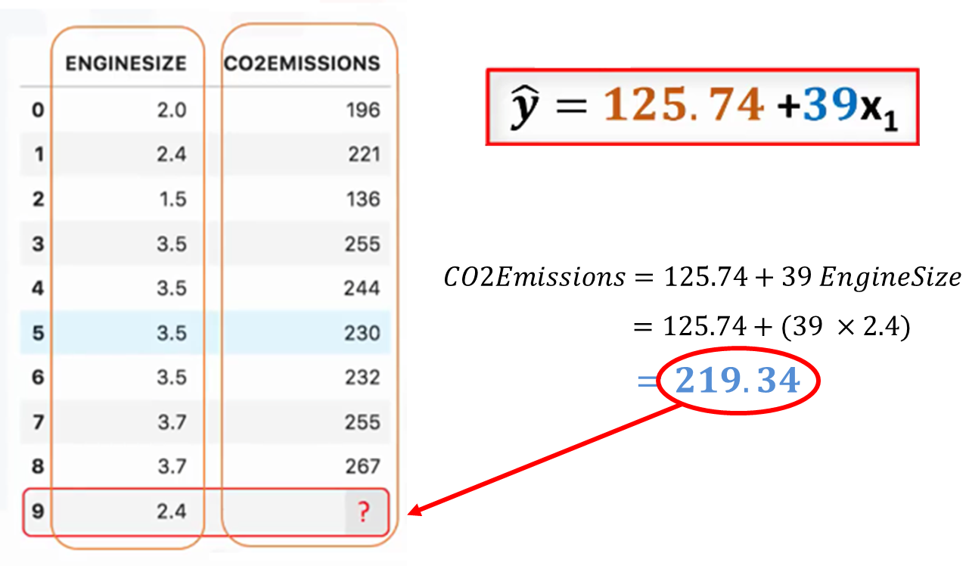
Prediction

Slide 13
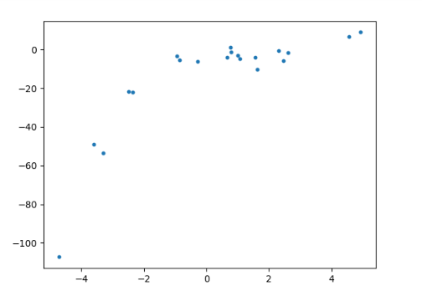
Linear or Nonlinear Regression?
Given the following data:
Should we use linear or nonlinear regression?

Slide 14
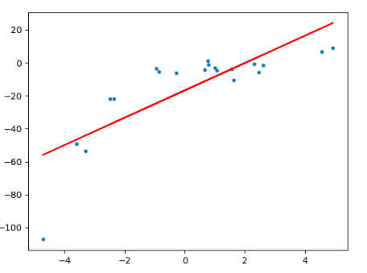
Linear or Nonlinear Regression?
Use linear model (degree 1):
Root Mean Squared Error (RMSE) of linear regression is 15.91.
R² score of linear regression is 0.64.
R² or R-squared (coefficient of determination): how close the data are to the fitted regression line.
Many data points are “far” from the line.
Condition: under-fitting

Slide 15
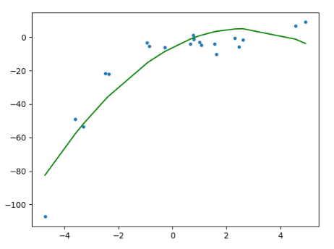
Linear or Nonlinear Regression?
Use nonlinear/quadratic model (degree 2):
RMSE of polynomial regression is 10.12.
R² score of polynomial regression is 0.85.
The line model is closer to the data distribution.

Slide 16
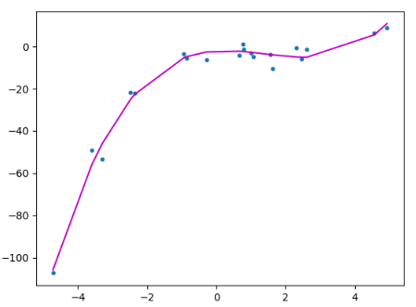
Linear or Nonlinear Regression?
Use nonlinear/cubic model (degree 3):
RMSE of cubic regression is 3.45.
R² score of cubic regression is 0.98.
The line model is even much closer to the data distribution.
Condition: appropriate-fitting / correct-fit

Slide 17
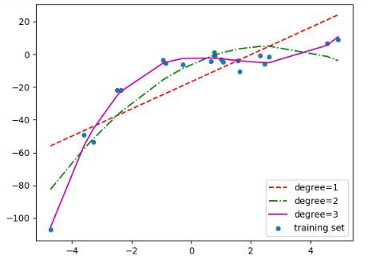
COMPARING THE THREE MODELS
Comparison between linear, quadratic, and cubic model:

Slide 18
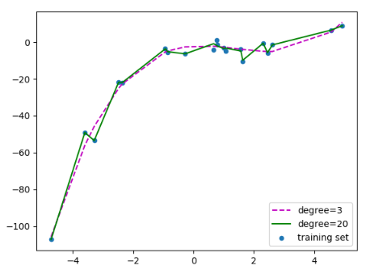
What about other degree ?
Let’s say using degree 20:
The line model also goes through “noise” data.
Condition: over-fitting

Slide 19
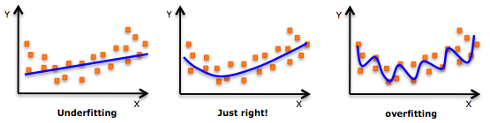
Underfitting vs Overfitting

Slide 20
GENERALIZATION
Components of generalization error
Bias: how much the average model over all training sets differ from the true model?
Error due to inaccurate assumptions/simplifications made by the model
Variance: how much models estimated from different training sets differ from each other
Underfitting: model is too “simple” to represent all the relevant class characteristics
High bias and low variance
High training error and high test error
Overfitting: model is too “complex” and fits irrelevant characteristics (noise) in the data
Low bias and high variance
Low training error and high test error

Slide 21
Bias vs Variance
Bias
Bias refers to an error from erroneous assumptions in a learning algorithm.
High bias can cause an algorithm to miss the relevant relations between features and target outputs (underfitting).
Variance
Variance refers to an error from sensitivity to small fluctuations in the training set.
High variance can cause an algorithm to model the random noise in the training data, rather than the intended outputs (overfitting).

Slide 22
How to Find Fitted Line?

Slide 23

The MSE (COST FUNCTION)
It is an absolute blunder to set ‘θ₁’ and ‘θ₀’ to zero for the above dataset. But how do we program the computer so that it knows how to evaluate whether a particular choice of parameters is poor or not.
This is where cost function comes into picture. Cost function is a function which tells the computer whether a particular choice of parameters is optimal or not.
There are several cost functions available, but one which is in our interests, and is also most widely used in regression based tasks is the Mean Squared Error (MSE) Cost Function, denoted by J(θ).

Slide 24
INTUITION BEHIND MSE COST FUNCTION
In MSE, the core operation being performed is the difference between the predicted output value, h(x) and the actual output value, y.
Furthermore, we square the difference because the predicted value might be greater than the actual value, or vice versa. It is crucial to remember that we would like to know the magnitude of difference, and not the direction of difference. As a side note, traditionally, this difference is also called as an error.
It is not sufficient to simply calculate how different our model’s output value is from the actual output value for one example alone.
The superscript ‘i’ denotes ‘i’-th input example, and we perform a summation over all ‘m’ input examples and divide by the total number of examples to calculate the final difference between our model’s predictions and the actual output values.

Slide 25
GRADIENT DESCENT
With the help of a cost function, how to determine whether a particular choice of parameters (‘θ₁’ and ‘θ₀’ here) are good or bad. If the cost function outputs a zero value for our chosen ‘θ₁’ and ‘θ₀’ values, then Eureka! We have figured out the optimal parameters for our model.
This is far less likely to happen. Once our cost function outputs a positive value, we need to figure out a way to modify our parameters — read as tweaking the parameters — so that the new parameters yield a lower cost function value.
Mathematically, gradient descent performs the minimisation of the cost function J(θ). Let us see how the plot of J(θ) with respect to the parameter values θ₀ and θ₁ actually looks like: …….

Slide 26
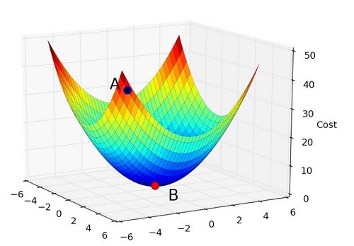
x and y axis correspond to θ₀ and θ₁ respectively, whereas the z axis corresponds to the cost, J(θ)

Slide 27
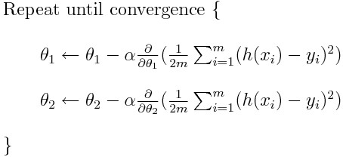
Our task now boils down to a standard optimisation problem in mathematics. Formally, we can describe gradient descent as follows: (Note: In the below figure ‘θ₁’ is θ₂ and ‘θ₀’ is θ₁)

Slide 28
Two subtle things in the above equations which are responsible for learning:
In which direction to descend? The slope of a curve (or a line for that matter) gives us a positive value when the curve is increasing and a negative value when the curve is decreasing. Furthermore, note that at a particular point, when a curve is increasing, then there will definitely be a minima towards its left, and vice-versa. Combining these two facts we get:
“When the slope of a curve is positive, then move towards left and when slope is negative, move towards right — because that’s where minima lies”
How much to descend in one step? This is our learning rate ⍺. Intuitively, to make the algorithm run faster we might want to choose as high a value as possible. While this logic seems to be right, there is a risk of over-shooting the minima and thereby making the algorithm slower to converge, or worse yet, diverging. Hence the step, in a single iteration, by which the gradient descent algorithm descends is the learning rate ⍺.
Note: Learning rate ⍺ is also called as a hyper-parameter. Hyper-parameter is a parameter whose value is set before the learning process begins.

Slide 29
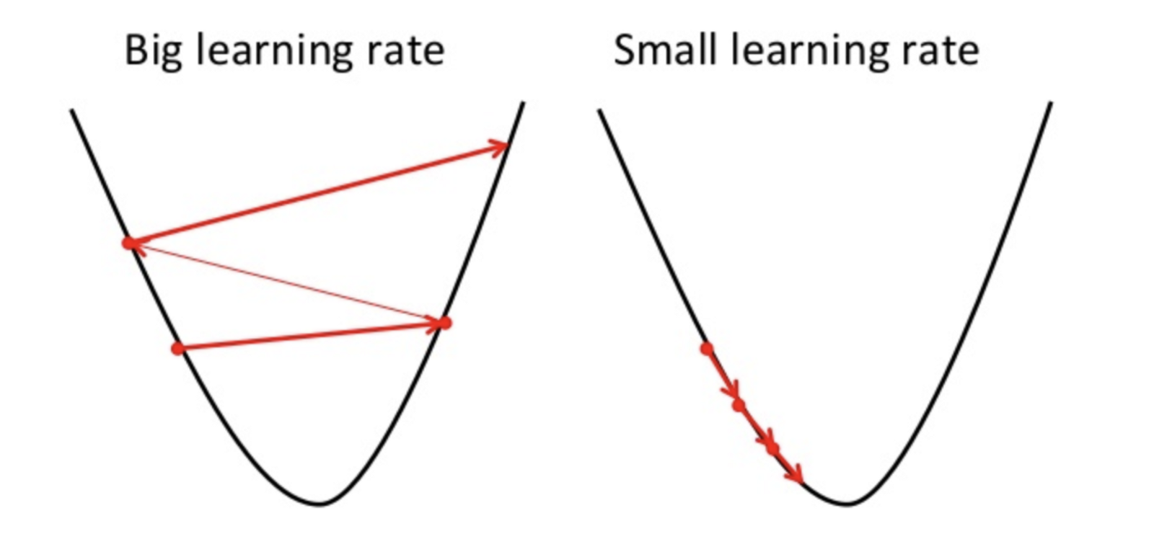
Optional Information: If you are curious to know how the gradient descent works (or descends) when the learning rate, alpha, is varied:

Slide 30
THE ALGORITHM OF SLR MODEL
We have talked about cost function and gradient descent. Let’s put them together in our linear regression model:
Grab the input dataset. Figure out what are the features, and what is the output variable which we are going to predict.
Initialise the weights of the features to zero and repeat the following two steps until convergence:
(a) Calculate the cost of our model for the selected parameters
(b) Update the parameters with gradient descent
After convergence, you get the final parameters for your model which hopefully will give you the correct predictions for unseen data.
Convergence: Simply put, it is an instance where there is no point in making a parameter update using gradient descent because the cost function has remained constant for quite some time.

Slide 31
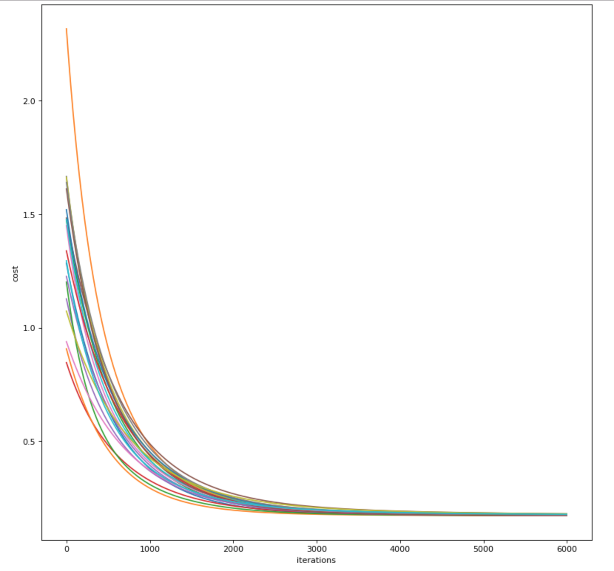
Practically, one can plot the variation of the cost function at every iteration of the above loop, and if the implementation is correct, you will see a curve which is more or less similar to the following figure
Evidently, we can see that after 4000 iterations, the cost function stagnates. This is how we determine the convergence.

Slide 32
LET’S GO TO MULTIVARIATE LINEAR REGRESSION
Sebagai seorang Data Scientist Sdr diminta melatih sebuah model multiple linear regression (MLR) yang akan digunakan untuk memprediksi PROFIT (dependent variable) suatu perusahaan berdasarkan 4 opsi atribut (independent variables) yaitu R&D SPEND, ADMINISTRATION, MARKETING SPEND, dan STATE. Dataset (startups.csv)

Slide 33
REGRESSION VS CLASSIFICATION
While regression allows you to predict a continuous variable, classification allows you to categorise data into different classes.
For example, you can use a regression based model to predict how the sales of a company will be in the next year.
However, if you want a self-driving car to determine whether an object on the road is a street sign, or a pedestrian, then you have to model your problem as a classification problem, rather than a regression problem.
So, let us understand how classification is done by solving the problem of “University admission prediction.”

Slide 34
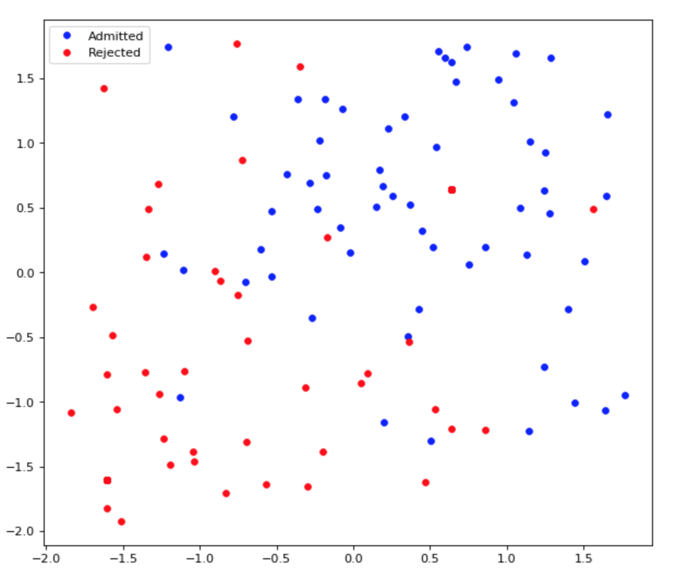
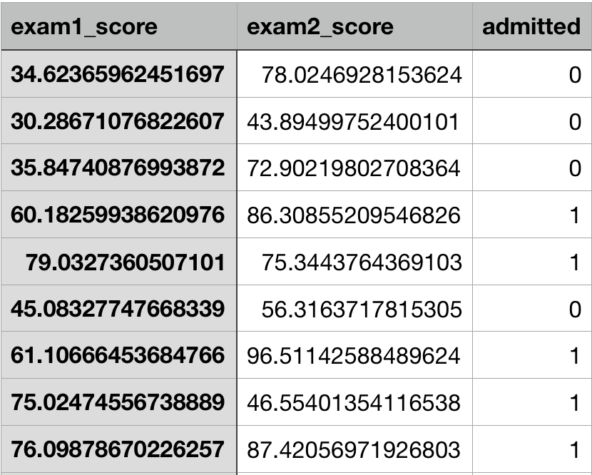
The problem is simple.
Our hypothetical University requires a student to take two examinations before he is considered for admission.
You will be given scores of a student on the two examinations and your task is to determine whether the student gets admitted into the University or not.
Furthermore, to build the model, you will be given historical data of former students who have applied to the University along with their admission decisions as follows:

Slide 35
To solve any supervised learning model, the following components are required:
A hypothesis to fit our data
A cost function which determines how our hypothesis is performing
An optimisation algorithm which adjusts the weights of the hypothesis to minimise the cost determined by the cost function
LET US DISCUSS ABOUT EACH OF THE THREE COMPONENTS:
Hypothesis
If you are familiar with Linear Regression, then you understand all the above three points very well. In classification, however, we need to tweak the definition of our hypothesis a bit. Consider the following equation: h(x) = w0 + w1x1 + w2x2
In classification, we need to categorise the data into buckets, i.e. a yes or a no. More concretely, in our above problem, we need to output a “Yes”, signalling that the student will get an admit, or “No”, signalling that the student will not get an admit.

Slide 36
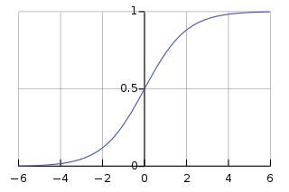
Mathematically, we can encode this information into our equation (of h(x)) by applying a sigmoid function.
y = 1/(1 + exp(-x))
The above function is called logistic function — which is a function belonging to the family of functions called sigmoid functions. The logistic function’s range, as we can see, is between 0 and 1. Hence, if we are to pass our output of h(x) to logistic function, g(h(x)) = 1/(1 + exp(-h(x))), we will be limiting the range to [0, 1].

Slide 37
It is not sufficient to limit the range of h(x) to [0, 1] alone. We need to output a yes or a no.
From the diagram above, it is clear that the curve is symmetric around y = 0.5. Therefore, we can safely say that, if the output of logistic function is greater than 0.5, we can treat it as a “Yes”, and if it is less than or equal to 0.5, we can treat is as a “No.”
Formally speaking, output ‘yes’ if: g(h(x)) > 0.5
g(h(x)) > 0.5 only if h(x) > 0 meaning w0 + w1x1 + w2x2 > 0
The parameters for this equation are w0, w1, and w2. So, basically, it is a straight line:
w0 + w1x1 + w2x2 > 0 → w0 + w1x1 > - w2x2 → (-w0/w2) + (-w1/w2) x1 > x2
c + mx > y where c = (-w0/w2), m = (-w1/w2), x = x1 and y = x2
Therefore, the equation represents the portion of the graph which is above the line y = mx + c.

Slide 38
Now, recall where this all started. We were trying to encode the information of “yes” or “no” into g(h(x)) — which led us to a point where we can say that the region above the line w0 + w1x1 + w2x2 is where we output “yes”, and the region below is where we output “no.”
This line, is referred to as decision boundary, which separates the two classes — in our case the students who get an admit and the students who do not.

Slide 39


MLE for logistic regression
Since we only have 2 labels, say y=1 or y=0. Assume that ŷ is the probability for y=1, and 1-ŷ is the probability for y=0 then we could write:
We could have density function of binary classification problem:
and the log likelihood function :

Slide 40

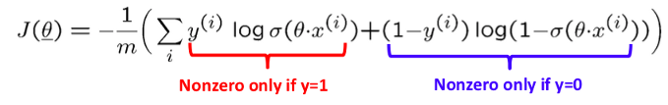
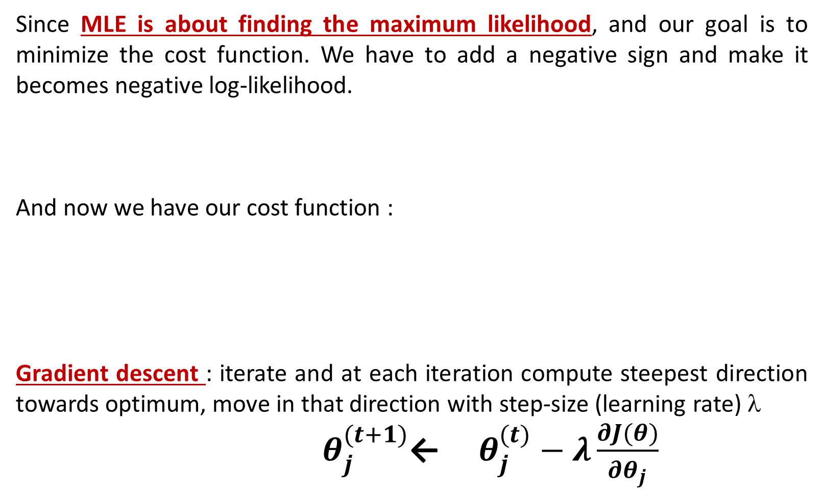
Since MLE is about finding the maximum likelihood, and our goal is to minimize the cost function. We have to add a negative sign and make it becomes negative log-likelihood.
And now we have our cost function :
Gradient descent : iterate and at each iteration compute steepest direction towards optimum, move in that direction with step-size (learning rate) λ
$θ_{j}^{(t+1)}$← ${ θ}_{j}^{(t)} − λ\frac{∂J(θ)}{{∂θ}_{j}}$

Slide 41
2. Cost Function
Need to come up with a new cost function for classification based problems. We will use y = 1 as a representation of “yes” and y = 0 as a representation of “no.”
log(P(y|x)) = Σ(y(i)log(h(x)) + (1 — y(i))log((1 — h(x))))
This equation is our cost function. It is also referred to as cross-entropy cost function. One important thing to remember is that, this function is a convex function! Hence there will be only a single minima:
3. Optimisation Algorithm
Similar to Linear Regression, we can use Gradient Descent to optimise our cross entropy cost function, without worrying that our model will be stuck at a local optima.
Our binary classifier is also sometimes called as logistic regression model. If you observe the derivation of our hypothesis and the cross-entropy cost function, you will notice that we have built a probability predicting regression model and made it a classifier by treating the probability greater than 0.5 as True, and less than 0.5 as False.

Slide 42
LEARNING PARAMETERS USING FMINUNC FROM SCIPY
The optimal parameters of a linear regression are found by implementing gradient descent. This time, instead of taking gradient descent steps, we are going to use an Octave built-in function called fminunc .
Octave’s fminunc is an optimization solver that finds the minimum of an unconstrained function. For logistic regression, we want to optimize the cost function J(θ) with parameters θ
We will pass to fminunc the following inputs
The initial values of the parameters we are trying to optimize
A function that, when given the training set and a particular θ, compute the logistic regression cost and gradient with respect to θ for the dataset (X, y).

Slide 43
LEARNING PARAMETERS USING FMINUNC FROM SCIPY
import scipy.optimize as opt
result = opt.fmin_tnc(func=cost, x0=theta, fprime=gradient, args=(X, y))
result :
array([-25.1613186 , 0.20623159, 0.20147149]), 36,0)
The parameters for this equation are w0, w1, and w2. So, basically, it is a straight line:
w0 + w1x1 + w2x2 > 0
-25.16 + 0.206x1 + 0.201x2 →

Slide 44
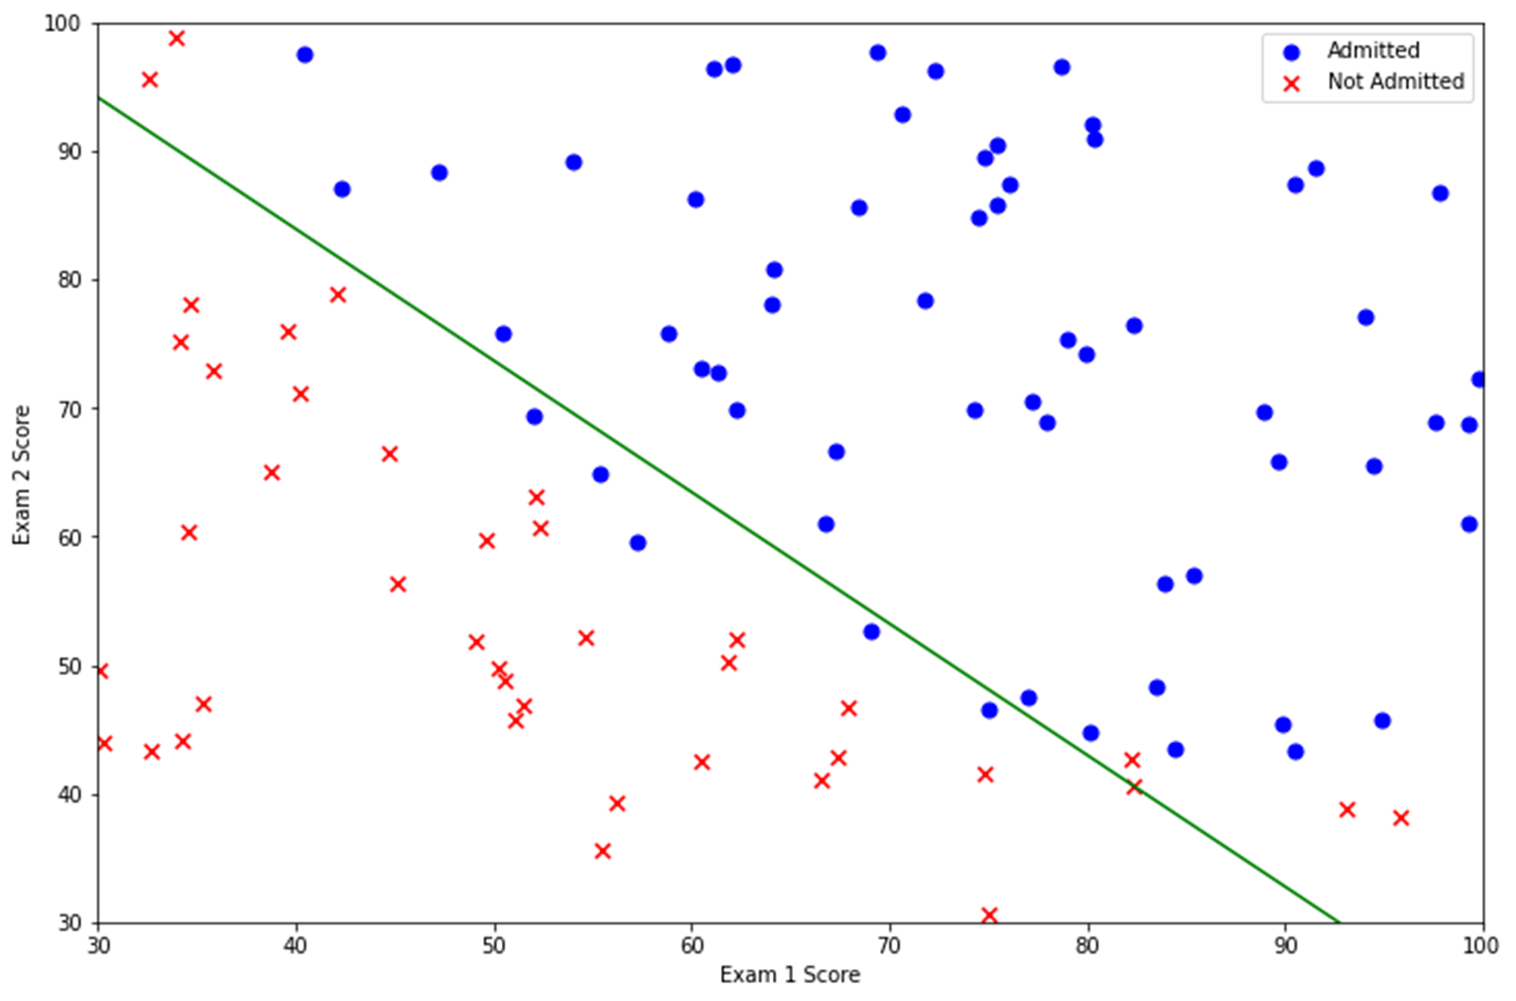

Slide 45
def intialization(n_features):
w = np.zeros((1,n_features))
return w, b
def sigmoid(x):
return 1 / (1+np.exp(-x))
def trainModel(w, X, Y, learning_rate=0.0001, no_iterations=500):
costs = []
m = X.shape[0]
for i in range(no_iterations):
# map the result to probability by sigmoid function
a = sigmoid(np.dot(w,X.T))

Slide 46
MAXIMUM LIKELIHOOD AND LEAST SQUARES

Slide 47
OLS REGRESSION RESULTS
Dep. Variable: Profit R-squared: 0.960
Model: OLS Adj. R-squared: 0.958
Method: Least Squares F-statistic: 347.6
Date: Sun, 21 Mar 2021 Prob (F-statistic): 3.70e-30
Time: 21:40:20 Log-Likelihood: -482.84
No. Observations: 47 AIC: 973.7
Df Residuals: 43 BIC: 981.1
Df Model: 3
Covariance Type: nonrobust
coef std err t P>|t| [0.025 0.975]
const 5.954e+04 5907.852 10.079 0.000 4.76e+04 7.15e+04
x1 0.7846 0.036 21.512 0.000 0.711 0.858
x2 -0.0596 0.044 -1.358 0.182 -0.148 0.029
x3 0.0153 0.014 1.131 0.264 -0.012 0.043
Omnibus: 0.254 Durbin-Watson: 1.812
Prob(Omnibus): 0.881 Jarque-Bera (JB): 0.448
Skew: 0.043 Prob(JB): 0.799
Kurtosis: 2.530 Cond. No. 1.59e+06

Slide 48
# define a function to calculate the log likelihood
def LogLikelihood(guess, true, n):
error = true-guess
sigma = np.std(error)
f = ((1.0/(2.0*math.pi*sigma*sigma))**(n/2))* \
np.exp(-1*((np.dot(error.T,error))/(2*sigma*sigma)))
return np.log(f)
# define my function which will return the objective function to be minimized
def MLRFunction(var):
yguess = (var[3]*x[:,2]) + (var[2]*x[:,1]) + (var[1]*x[:,0]) + var[0]
f = LogLikelihood(yGuess, Y, float(len(yguess)))
return (-1*f)

Slide 49
# let’s start with some random coefficient guesses and optimize
nvar = 4
var = np.zeros(nvar)
var[0] = 10000
var[1] = 2
var[2] = -.25
var[3] = .025
results = minimize(MLRFunction, var, method = 'Nelder-Mead', options={'disp': True})

Slide 50
Optimization terminated successfully.
Current function value: 482.839220
Iterations: 327
Function evaluations: 573
fun: 482.83922049734485
message: 'Optimization terminated successfully.'
nfev: 573
nit: 327
status: 0
success: True
x: array([ 5.95448148e+04, 7.84568165e-01, -5.95987283e-02, 1.53270158e-02])

Slide 51
# compute the neg log-likelihood
cost = (-1/m)*(np.sum((Y.T*np.log(a)) + ((1-Y.T)*(np.log(1-a)))))
# calculate the gradient
dw = (1/m)*(np.dot(X.T, (a-Y.T).T))
# update w
w = w - learning_rate*dw.T
if i%100==0:
costs.append(cost)
return w, costs

